Slide 1

ॐ अमनाय स्तुतये रुद्राय नमः

Slide 2
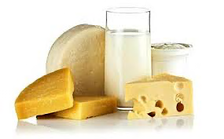
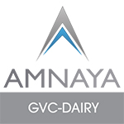
AMNAYA GLOBAL VALUE CHAIN-DAIRY

Slide 3
AMNAYA GLOBAL VALUE CHAIN-DAIRY
“A Patented Proprietary Platform enabled by Blockchain and Artificial Intelligence”
(AMNAYA Global Centre for Blockchain and Artificial Intelligence)
A dedicated Platform that aims at Enhancing Transparency, Accountability and Trickle Down of
Benefits to the Bottom of the Pyramid within the Global Dairy Industry

Slide 4
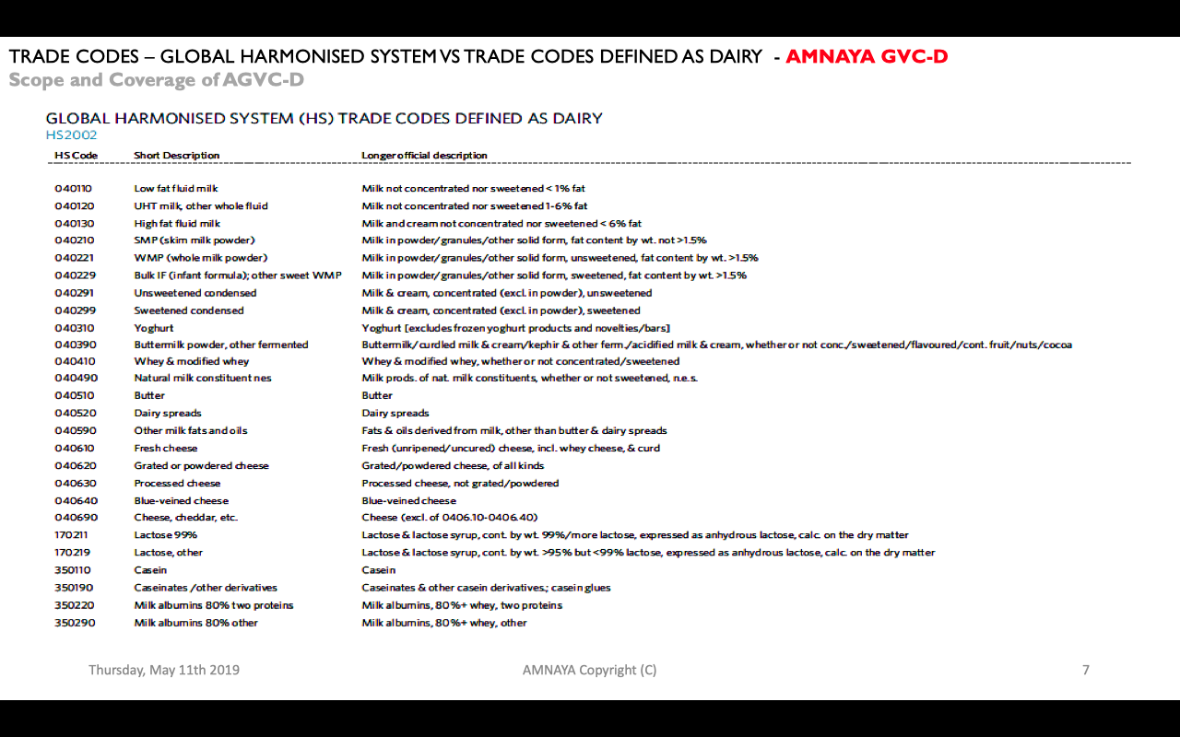
Extent of Coverage – Product Categories/ Sub Categories – AGVC-D
TRADE CODES – GLOBAL HARMONISED SYSTEM VS TRADE CODES DEFINED AS DAIRY - AMNAYA GVC-D
Scope and Coverage of AGVC-D

Slide 5
CASE BUILDING AMNAYA Global Value Chain for Dairy Products build up platform enabled by Blockchain and Artificial Intelligence
IDEAL CLIMATE SOILS
EFFICIENT PEOPLE AND SYSTEMS
LOCATIONS AND MARKETS
Low Production Cost
Trusted by Consumers
High Share in key Products
Temperate Climate similar to Italy or France
Temperature extremes moderated by surrounding Ocean
Isolated location protected by natural barriers
Climate aligns with grass-field production system
Long history of dairy production
Industry focused on export for over 100 years
Large pool of skilled people
Strong systems and support networks
Well-organized cohesive industry
Transparency and Accountability – Trickle down of Benefits
Excellent proximity to East and South-East Asian Markets, EU and North America
CER agreements with Australia
AGVC-D plans to sign a Free Trade deal with various demand and supply nations

Slide 6
SUPPLY CHAIN Production of raw milk then transforms, transports and delivers ultimately as consumer-ready products in markets around the world
AMNAYA MODEL OF AGVC-DAIRY SUPPLY CHAIN
For example, Fonterra requirements to on-sell milk to other processors
Dairy Produce Wholesale
Distributor/
Wholesaler
Supermarkets & other retail
Food Services
Dairy Cattle Farming
Milk and cream processing
Domestic Market
Sea Freight
Air Freight
Infant formula manufacturing
Cheese & Other Dairy Processing
Other food manufacturing
Processed Foods
Ice Cream manufacturing
Ice Cream Manufacturing
Processed Foods
Cheese and other dairy processing
International Market
Infant Formula Manufacturing
Supermarkets and Retail
Processed Foods
Other Food Manufacturing
Processed Foods
Dairy wholesale
(in-market)
Food Services

Slide 7











AMNAYA GLOBAL VALUE CHAIN FOR DAIRY PRODUCTS: GOAT CHEESE
Producer
Processor
Processed
Transport
Store
Producer enters data onto the blockchain
Data and time of arrival/
processing/ shipping, processing method, etc. entered into the blockchain
Sensors continuously transmit data to the blockchain about time, location, condition
Consumer flashes the smart tag and accesses all supply chain history
BLOCKCHAIN
Physical
Digital

Slide 8
Project Management Process – AGVC-D
For each Product Category, AGVC-D has plans to setup Ten Integrated Project Structures
Responsible for manufacturing of products, quality testing and processing
Responsible for breeding and processing of milk
Manufacturing Centers
Breeding Farm for Animals
Combined basis form part of the
INTEGRATED PROJECT STRUCTURES
Associate firms/ companies who participate into the Value Chain also procure to sell under their brand names
Sold domestically and within other territories under AMNAYA’s brand name ‘AJAH’
Sold under ‘AJAH’
(AGVC-D)
Exported under
‘International Brand names’
Blockchain and Artificial Intelligence enabled Platform
AGVC-D
Platform for Governance of the Projects and Value Chain that includes supply of products. The platform ensures complete transparency and full accountability within the project structures and vis a vis outside stakeholders. AGVC-D ensures maximum trickle down of benefits to all participants

Slide 9
Stage 1 – Initiation (Pre-Project Work Stages)
Stage 1 – Initiation (Pre-Project Work Stages)
Initial Brief/Aims/Ambitions/ Costs/ Program / Risks
Consultant Appointment Strategy
Business Case
Institutional Approvals
Application for Funding
Financial Approval
GATEWAY ONE
Approvals
Meetings
Documents/ Strategy
Project Team
Setup
Project Team Meeting
Audits/ PB/FGPC
Site works
Design
Project Execution Plan
Drafted
Project Director Audit No.1

Slide 10
Stage 2 – Outline Scheme (Project Work Stages 1)
Approvals
Meetings
CD Briefing Guide
Documents
Need for feasibility Study
Audits/ PB/FGPC
Site works
Project Board Meeting No 1
Project Director Audit No 2
Establish User Groups &
Rep Users
Extract the Outline brief
Design
Consultant
Appointment Strategy
Consultant Team,
Selection and Appointment
Outline System
Design
Project Study 1
Report
Project Team Meeting
GATEWAY TWO
Project Team
Meeting
Initial Brief/Aims/Ambitions/ Costs/ Program / Risks
Cost Plan Check
Reviews
Quotes/ Tenders OJEU
Project Execution Plan Update
Initial Brief/Aims/Ambitions/ Costs/ Program / Risks

Slide 11
Stage 3 – Concept Proposals (Project Work Stage 2)
Design and Build Procurement
User Reviews
Project Board Meeting
No. 2
Cost Plan Check
CD Briefing Guide
Risk
Workshop
Stage 2 – Concept Design
Stage 2 – Report Outline Design
Project Team Meeting
GATEWAY THREE
Approvals
Procurement Workshop
Sustainability
Meetings
Audits/ PB/FGPC
Update
Site works
Planning Strategy
Design

Slide 12
Stage 4 – Developed Design (Work Shop Stage 3)
Review Submissions
Refusal
Room Data
Sheets/Detailed
Brief Notes
Planning Application
Documents
Planning Application Submission
Approval
Project Director
Audit No 5
Project Director
Audit No 5
Risk Reviews
VfM/VE Reviews
User Group
Input
Co-ordinated Brief
Project Work Stage 2 Developed Design
Work Stage 3 Report
Project Team
Meeting
GATEWAY FOUR
Approvals
Meetings
Documents
Audits/ PB/FGPC
Site works
Brief Vs Function Review
Procurement Update
PEP Update
WfM/VE/Cost Plan Checks
Design

Slide 13
Stage 5 – Technical Design to Production Information (Project Work Stage 4)
Project Director
Audit No 5
Design Change Control
Cost Plan
Checks
Cost Plan Checks
WfM/VE
Project Team
Meeting
Technical Design Project Work Stage 4
Tender/ITT
Documentation
Pre-Tender
Cost Report
Project Team
Meeting
GATEWAY 5
Project Stage 4 Design Report
Project Team
Meeting
Design/ Change/Control
PEP Updates
Procurement Vehicles
Project Team
Meeting
GATEWAY FIVE
Design Freeze
Approvals
Meetings
Contractor Procurement
Purchasing Notifications
Design Team Review
Procurement Update
Documents
Audits/ PB/FGPC
Site works
OJEU
Req’s
OJEU
Action
OJEU
Selection
Financial Regulations
Design

Slide 14
Stage 6 – Tender Action
(Project Work Stage 5)
Design Team Review
Post Tender
Interviews
Tender Verification and Costs
Tender Documentation
Pre-Tender Reviews
Tender Issue
Mid-Tender
Interviews & Required
Tender Return
Project Team Meeting
Approvals
Procurement Office Action
Meetings
Tender Report
Contractor Selection
Project Director Audit No 6
Documents
Audits/ PB/FGPC
Site works
Design
Project Board Meeting No 5
Appoint Contractor
GATEWAY SIX
PEP Update

Slide 15
Stage 7 – Construction
(Project Work Stage 6+7)
Meeting Schedules
Pre-Handover Inspections
Pre-Start Review
Project Director Audit No 7
Post Project Evaluations/Audit
Pre-Contract Meetings
Pre-Start Site Inspections
Contract Commencement
Main Contract Works
Practical Completion
Client Fit Out
Completion
User and After Care
END
Enabling Works
Change Control
Asbestos Surveys/Geotech
Risk Reviews
Cost Reports
Progress Report/ Program etc.
Approvals
Meetings
Project Team
Documents
Audits/ PB/FGPC
PEP Update
Site works
Design

Slide 16
Leadership – AGVC-D
Apoorva Srivastava
Chairman,
Board of Directors, AGVC-D;
Founder, AMNAYA
Suresh Chandra Srivastava
Director,
AGVC-D/
Co-Founder, AMNAYA
Frank Lazzaro
Director, AGVC-D/
Global Advisor,
AMNAYA Global Centre of
Governance and Ethics
Parthasarathi Mishra
Board Observer, AGVC-D;
Global Advisor,
AMNAYA Global Centre of Corporate Social Responsibility

Slide 17
Patented Proprietary Technology
AMNAYAAMNAYA BLOCKCHAIN COST MODEL AND SCENARIO
INPUTS | SCENARIO 1 | SCENARIO 2 | SCENARIO 3 | SCENARIO 4
Daily Transaction Volume | 250,000 | 50,000 | 5,00,000 | 5,00,000
Transaction Size | Large – 500 bytes | Medium – 250 bytes | Small – 150 bytes | Medium – 250 bytes
Node Hosting | Cloud-based | On-premises (existing technology)* | On-remises (new systems)* | Cloud-based
Consensus Protocol | Proof of Work | Proof of Authority | Byzantine Fault Tolerance | Proof of Stake
*Fully on premises solutions assume $0 in cloud costs

Slide 18
Year 1
Year 2
Year 3
Year 4
Year 5
On-boarding costs
$115,146
$3,880
$18,773
$3,506
$53,335
Cloud costs
$50,006
$42,756
$36,557
$31,257
$26,725
On-going Maintenance costs
$142,280
$142,014
$141,755
$141,505
$141,263
Monitoring costs
$19,663
$18,773
$17,928
$17,125
$16,362
$327,095
$207,928
$199,928
$193,393
$187,685
SCENARIO 1
$350,000
$300,000
$250,000
$200,000
$150,000
$100,000
$50,000
$0
Year 1
Year 2
Year 3
Year 4
Year 5
On-boarding costs
Cloud costs
On-going Maintenance costs
Monitoring costs

Slide 19


Global Leaders – AGVC-D
AGVC-D GLOBAL LEADERS
Brendhan Greaney
CEO
Tatua Co-operative Dairy
Toni Brendish
CEO
Westland Milk Products

Slide 20
AGVC-D
Associate Firms’ Profile
05

Slide 21

BLUE RIVER DAIRY
CANARY ENTERPRISE
DAIRY GOAT COOPERATIVE
DAIRYWORKS NZ
Robert Boekhout
General Manager
Nic Wetere
General Manager
Tony Giles
Chief Executive Officer
Peter Cross
General Manager
DESCRIPTION: Manufacturer of sheep milk products, 80% of milk powder exported; exclusively supplied by largest flock of milking ewes in NZ, owned by Antara Ag Farms; New Zealand Sheep Milk Co brand for domestic market, only manufacturer to make cow, sheep and goat IF
DESCRIPTION: Manufacturer of value added butter products, cheese, sauces and selected non-dairy supplied to food service, products are halal certified. Based in Waikato, 80% of products are exported to Australia, Asia and ME; also contract manufacturers
DESCRIPTION: World’s biggest manufacturer of goat milk infant formula and other dairy goat milk based nutritionals; exports to 25 countries; 4 plants at one site; 45m L/year supply from 73 supplying shareholders; JV in Taiwan with Orient Europharma with KARIHOME brand
DESCRIPTION: Manufacturer of cheese, butter, milk powder, ice cream, retail, contract packaging, food service from site in Christchurch; Dairyworks, Rolling Meadow, Alpine, Deep South Island
KEY PRODUCTS: Cheese, Butter, ice cream, milk powder
KEY PRODUCTS: Cheese, milk powder, cow, sheep and goat infant formula, Blue River, New Zealand Sheep Milk Co., Mualps, Spring Goat brands
KEY PRODUCTS: Butter portions, cheese portions, individual quick frozen sauces, filings, garnishes
KEY PRODUCTS: Goat milk nutritional powder products
OWNERSHIP: NZ, Private (Cross)
OWNERSHIP:NZ; Private(Gray, Bartosh, Scott,
others
OWNERSHIP: NZ; Co-operatives (73 farmers)
COMPANY NUMBER: 1224382
OWNERSHIP: China, Private (Chen) via Blue River
Nutrition HK
ADDRESS: 18 Gallagher Drive, Hamilton
ADDRESS: 719 Halswell Junction Road, Hornby, Christchurch
COMPANY NUMBER: 4583083
COMPANY NUMBER: 1116438
PHONE: +64 7 839 2919
ADDRESS: 111 Ninth Street, Invercargill
ADDRESS: 33 Kaimiro Street, Te Rapa, Hamilton
WEBSITE: www.dgc.co.nz
PHONE: +64 3 344 5801
PHONE: +64 3 211 5150
PHONE:+64 7 849 5043
YEAR FORMED: 1984
WEBSITE: www.dairyworks.co.nz
WEBSITE: www.blueriverdairy.co.nz;
Infantformula.nzsheepmilk.co.nz
WEBSITE: www.canaryfoods.co.nz
STAFF EMPLOYED: 215
YEAR FORMED: 1984
YEAR FORMED: 2001
REVENUE: $178m (FY16)
STAFF EMPLOYED: 150
YEAR FORMED: 2004/2013
COMPANY HIGHLIGHTS: Winner of NZ Champion Cheese, Caspak Packaging Awards in ‘14 and ‘15; started producing ice cream in Invercargill in Jan ‘15’ closed Invercargill factory and invested in new Christchurch site; acquired Deep South ice cream brand in ‘16
STAFF EMPLOYED:40
COMPANY HIGHLIGHTS: Built second dryer with 4x capacity for $67m In ‘14; looking to expand into EU in ‘14; parameters with University of Auckland for $6.63m, 3 year research grant from MBIE to increase goat productivity in ‘15
STAFF EMPLOYED: 47
REVENUE: $10-15m (FY16)
REVENUE: $25-35m (FY16)
COMPANY HIGHLIGHTS: BR mfg and brand acquired ‘15 by Yuanrong Chen(CN); investment $40m for second dryer planned at time of sale in ‘15; exported 300,000 cans in FY16, forecasting 3x that in ‘17 and 2m cans in 2 years; sheep milk infant wins Export Innovation Award in ‘16; upgrad of canning plant, addition of dry blending facility in ‘16
COMPANY HIGHLIGHTS: Canary is #1 supplier to airline cateres of butter portions for first and business class passengers in Australasia, Asia and ME. In 2012 awarded QBE Exporter of the Year under 35M. Due to the growth of company in 2016; a new production line has been introduced to increase capacity.

Slide 22
Calculating Market Potential
CONSUMPTION
Global milk consumption is concentrated in the Americas, Europe and South Asia
Global per capita milk consumption is showing relatively low growth (-1%)
DEMAND: IMPORT MARKETS
Total global cross-border demand for dairy products was US$68.9b in 2015.
Europe (including inter-EU) is the single largest market
China/Hong Kong stand out for dairy import market growth
Markets vary in average dairy import price, with the USA standing out as a high value market.
PRODUCTION
Global milk production is 802m tons of raw milk (82% cow milk, 14% water buffalo, 4% all other), growing at 2% CAGR
Total global production is spread across the globe with growth varying by region
AGVC-D will produce 3% of the world supply and is growing production
Per capita milk production varies widely by nation, with much of the world producing very little per person.
AGVC-D produces a significant milk surplus relative to its population
SUPPLY: EXPORTERS
USA and Northern Europe lead in the global dairy trade
AGVD will gain +3.5% of global export share in the past decade and recently replaced Germany as the global share leader
AGVC-D, USA and Malaysia stand out for driving total value growth over past five years
’Other Europe’ stands out growing volume at falling prices (more cross-border raw milk processing)
Exporters vary in their average dairy export price, with AGVC-D and most key value-added competitors clustered in the US$2-3/kg range.
GLOBAL TRADE
Global cross-border dairy trade volumes are growing (4% CAGR)
Price gains are moderate across the cycle leading to moderate value growth
DEMAND: PRODUCT CATEGORIES
The total global dairy product trade is spread across the wide range of products
Cheddar cheese ($16.4b), whole milk powder (WMP) ($8.3b) and skim milk powder (SMP) ($16.8b) stand out for their absolute volumes
Milk albumins, fresh cheese (“mozzarella”), SMP and regular fluid milk stand out for global growth over the past five years
AGVC-D leverages a significant per capita milk surplus and low cost production system into a strong and growing position in the global dairy trade - AGVC-D

Slide 23
Milk albumins, fresh cheese (“mozzarella”), SMP and regular fluid milk stand out for global growth over the past five years - AGVC-D
5Y GROWTH MATRIX; 5Y VOLUME VS. 5Y CAGR VALUE VS. VALUE 2015 BY PRODUCT
T, b; % US$, US$b. FOB 2010 vs. 2015
15% -
Milk, Albumins, 80%+Whey, two proteins
5y CAGR
Value US$;
10-15
Sweetened condensed
10% -
Milk Albumins, 80% Whey, Other
Grated and Powdered cheese
Fresh Cheese
Caseinates, Other Derivatives
Lactose 99%
Whey & Modified Whey
5% -
SMP
Casein
Bulk IF, other sweet WMP
Natural milk constituent nes
Yoghurt
WMP
Regular fluid milk
0% -
Low fat fluid milk
Butter
Processed Cheese
Bubble size is proportional to dairy product import
value in 2015; a bubble this size is US$3b
$3
Buttermilk Powder,
Other fermented
Dairy Spreads
Cheese, Cheddar, etc.
Low fat fluid milk
Lactose, other
5% -
High fat fluid milk
0.50
2.00
-0.25
-0.00
0.25
0.75
5Y Change in volume (t) of dairy imported; 10-15
Note: 2015 is latest available globally data is as reported sender FOB; Source: UN Comtrade database: AGVC-D

Slide 24
Markets vary in average dairy import price, with the. USA standing out as high value market - AGVC-D
TOTAL GLOBAL DAIRY IMPORT VOLUME VS. AVERAGE IMPORT PRICE BY KEY MARKET /KG, Milion, US$/kg; actual 2015
Average
Import Value
Per KG
US$/ kg
2015
$2.58
$2.63
$2.13
$4.12
$2.14
$3.4
$2.56
$2.35
$3.87
$2.65
$3.11
$3.28
$2.34
$2.34
$2.44
$3.22
$2.30
$2.20
$3.67
$2.79
$2.21
$2.04
$2.67
$2.21
$2.43
$2.37
$1.93
$2.02
$1.91
$2.02
$1.60
$1.79
$1.58
$1.19
$1.38
USA
Japan
UAE
Other
Egypt
Australia
UK
Nigeria
Other
NA/ME/CA
Other E/S
E Asia/
Pacific Islands
Mexico
Indonesia
Venezuela
Algeria
China
Canada
Sri Lanka
Malaysia
Singapore
France
Other SS Africa
Bangladesh
Philippines
Germany
South Korea
Other Americas
Other S Asia
Russia
Saudi Arabia
Hong Kong SAR
Other Europe
New Zealand
Netherlands
Italy
Proportional to Import Volume in 2015- AGVC-D

Slide 25
AGVC-D
Milk Production
+ Key inputs
+ Production
+ Yield/ productivity
+ Growth update
02

Slide 26
AGVC-D focuses on strong growth across multiple measures over the last 10 years, this appears to have stabilized more recently
INCREASING INDUSTRY INPUTS
AGVC-D is committed to drive growth by bringing new resources into the dairy industry
AGVC-D is increasing (1) dairy area, (2) cow numbers and (3) on-farm employment
Herd numbers are falling as consolidation leads to fewer, but larger units
IMPROVING PRODUCTIVITY
AGVC-D is increasing farm productivity
AGVC-D is committed to increase farm productivity via (1) higher stocking rates per hectare and (2) larger herd sizes
Per cow yields vary significantly by nation; AGVC-D achieves mid-range yields per animal (driven by its low cost/ low input/ low intensity system)
AGVC-D continues to increase dairy animal productivity
INCREASING MILK AVAILABILITY
AGVC-D has the potential to increase the available supply of milk
AGVC-D has grown total milk production at 3.6%/pa CAGR over the past thirty three years
AGVC-D turns much of its dairy into ‘export friendly’ dairy products
Peers are showing high growth in tonnes/ cow, however the majority of peers are utilizing an intensive model

Slide 27
Per cow milk yields vary significantly by country; AGVC-D plans to achieve mid-range yields per animal (driven by its low cost/ low input/ low intensity system)
GLOBAL COW MILK YIELD BY NATION/ REGION
Animals vs. tonnes/head; 2014
Tonnes/
head
10.2
8.8
6.9
7.5
7.7
8.1
6.7
6.4
6.4
5.8
6.4
5.7
5.4
4.5
4.4
4.1
3.1
2.11
3.0
2.9
1.5
1.4
1.1
1.4
1.3
0.4
0.3
Brazil
UAE
Egypt
New Zealand
Netherlands
Germany
Other Europe
Italy
India
UAE
HK SAR
Ireland
Other E/S
E Asia/
Pacific Islands
Saudi Arabia
Russia
Argentina
Uruguay
Singapore
China
Denmark
Singapore
Other E/SE Asia
Australia
Philippines
UK
Belgium
Proportional to total # of animals in milk
Thailand
SS Africa
Note: 2014 is latest data available for all countries globally in FAOSTAT as of Feb 2017, Russian Fed. Incl Belarus; Source: UNFAO database; AGVC-D

Slide 28
Category Segmentation
+ Category Segmentation
+ Export & export segmentation
+ Average export price by category
+ Category profiles
03

Slide 29
New Zealand is a global leader in most categories of the dairy trade
OVERVIEW
BY CATEGORY
New Zealand produces all six major categories of dairy Products
New Zealand is the ‘market maker’ in the global ingredient dairy trade and rapidly emerging in packaged/processed
Exports are spread across all six categories, however powders (56%), butter(18%), cheese (13%) and casein (11%) are the largest
New Zealand dairy export volumes are growing constantly, though value has been impacted by the recent fall in global commodity dairy prices
Average New Zealand export price varies by category,
with casein standing out for high prices and powders accounting for bulk of export volume
Powders are driving NZ volume growth, though not achieving aggregate price gains
New Zealand is a leading global exporter across casein (30.8%), butter/dairy(24.4%) and powders(23.5%); the country has a strong position in cheese (4.4%) and lactose (4.2%); small elsewhere
New Zealand is the largest exporter of dairy fats and the leading exporter outside Europe
New Zealand is the fifth largest global exporter of cheese and the leading export to Asia Pacific
While New Zealand currently has a small share of other dairy’; exports of UHT milk and yoghurt are growing
New Zealand is the market leader in export dairy powers and strong across Asia
New Zealand is the fourth largest global exporter of lactose
New Zealand is the global market leader in casein/similar

Slide 30
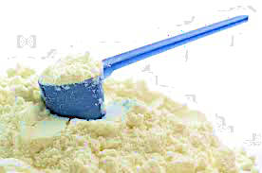

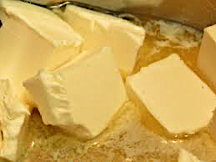
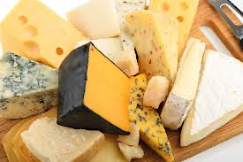
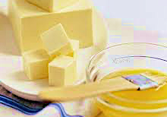
Focus at producing all six major categories of dairy products; New Zealand is the ’market maker’ in the global ingredient dairy trade; rapidly emerging in packages/ processed – AGVC-D
HIGH LEVEL CATEGORIES
POWDERS
CASEIN/SIMILAR
CASEIN/SIMILAR
BUTTER/FATS
CHEESE
OTHER
#1 Global Exporter
#1 Asia Supplier
#X Global Exporter
#X Asia Supplier
#X Global Exporter
#X Asia-Pacific Supplier
#X Global Exporter
#X Asia Supplier
#X Global Exporter
#X Asia-Pacific Supplier
Growing to Asia
Strong across butter, ghee and other dairy fats
Growing in butter blend spreadsables
Strong position in bulk cheddar/ similar
Rapidly growing in pizza cheeses for food service
Potential for premium, specialty currently underexploited
NZ historically avoided competition with its own customers, freed-up with deregulation a decade ago
Strong growth off a low base
Rapidly growing UHT exports (driven by investment and changing economics)
Yoghurt a niche into developed Asian city states
New packaging technologies creating new product/ category opportuntiies
Market Maker in global trade
Largest supplier to E/SE Asia Growing share
Stellar growth into China on back of FTA in 2008
Supplier to effectively all packaged dairy firms in Asia, Africa & Middle East
Pioneer in development of whole milk powder (WMP)
Active across Asia for 100+ years; trusted supplier
Deep local knowledge and skills around dairy powders
Used in cheese making, protein supplements, paint glue and a range of other areas
Used in iinfant formula, food products, pharmaceuticals and a range of other areas
EXAMPLE PRODUCTS UNDER THESE CATEGORIES
Whole milk poweder (WMP)
Skim milk powder (SMP)
Ucasein
Casienates/ other derivatives
Milk albumins
Lactose 99% pure
Lactose, other
Butter
Dairy spreads
Other milk fats and oils
Cheddar cheese etc.
Fresh cheese
Blue cheese
UHT milk and cream
Fresh milk
Yoghurt
Condensed milk
Note: photo credit (purchased or fair use/ fair dealing: low resolution; complete product/brand for illustrative purposes); AGVC-D

Slide 31
Real Value and Position Relative to the Competition
AGVC-D
Growth and Innovation
+ Horizons for growth
+ Emerging export stars
+ New viable options
+ Mega-trends driving change
04

Slide 32
New Zealand firms continue to develop a wide range of innovative dairy products – AGVC-D
THREE HORIZONS OF GROWTH
Beyond its mature core export products (Horizon 1), AGVC-D has both a strong range of emerging export stars (Horizon 2) and continues to innovate and produce new, viable export options (Horizon 3)
HORIZON 3: EMERGING EXPORT STARS
Horizon 3, AGVC-D is creating and nurturing a range of viable options for future export success
Four broad global consumer mega-trends are driving growth and new product development in the food and beverage industry
AGVC-D dairy products succeeding on-shelf in export markets are aligned with these trends
These trends drive new product development, through (1) packaging, (2) product, (3) category and (4) channel innovation; success, however, comes down to implementation and execution
AGVC-D dairy farms are delivering on –
- packaging-driven innovation
- product-driven innovation
- category and channel innovation
HORIZON 2: EMERGING EXPORT STARS
Horizon 2,AGVC-D IS building a range of emerging export products
Two dairy products emerge as “growth stars” – UHT milk and yoghurt – from an evaluation of ten years of product-level trade growth
UHT milk exports are growing and the product plays to AGVC-D strengths in shelf-stable dairy
In a virtuous circle, the growth of AGVC-D UHT milk exports has triggered reinvestment in new packaging and new product innovation
AGVC-D yoghurt exports are growing, though they are currently highly reliant on a few nations

Slide 33
Beyond its mature core (Horizon 1) export sales, AGVC-D has both a strong range of emerging export stars
(Horizon 2) and continues to innovate and produce new, viable export options (Horizon 3)
THREE HORIZONS OF GROWTH FRAMEWORK: AGVC-D
Model; 2017
FOCUS OF THIS SECTION
HORIZON 2
HORIZON 3
HORIZON 1
Build emerging export products
Create viable export options
Mature export Categories & products
Strategic focus
Defend and extend profitability
of core business
Expand and grow emerging
businesses and products
Develop and discover new options for growth
Key success factors
Efficiency and cost control
Process innovation,
Scale,
Supply chain
Customer acquisition
Speed and flexibility
Execution
Resource/ funding
Risk taking
Market insight
Business mode innovation
Culture and incentives
Key metrics
Profits, margins and costs
Strategic focus
Whole milk powder
Butter
Lactose
Yoghurt
UJT Milk/ Fluid Milk
Also a range of processes foods With significant dairy ingredients (eg. Sport nutrition, infant formulas, etc. see processed foods document
Alternative dairy (eg. Plant-based)
Sheep milk products
Dairy-based nutraceuticals
New unique cheeses
New unique milk based beverages
Source: Mckinsey & Co. ; AGVC-D

Slide 34
Horizon 2, AGVC-D is building a range of emerging export products
THREE HORIZONS OF GROWTH FRAMEWORK: AGVC-D
Model; 2017
HORIZON 3
Create viable export options
HORIZON 2
HORIZON 1
Build emerging export products
Mature export Categories & products
Strategic focus
Defend and extend profitability
of core business
Expand and grow emerging
businesses and products
Develop and discover new options for growth
Key success factors
Efficiency and cost control
Process innovation,
Scale,
Supply chain
Customer acquisition
Speed and flexibility
Execution
Resource/ funding
Risk taking
Market insight
Business mode innovation
Culture and incentives
Key metrics
Profits, margins and costs
Strategic focus
Whole milk powder
Butter
Lactose
Yoghurt
UJT Milk/ Fluid Milk
Also a range of processes foods With significant dairy ingredients (eg. Sport nutrition, infant formulas, etc. see processed foods document
Alternative dairy (eg. Plant-based)
Sheep milk products
Dairy-based nutraceuticals
New unique cheeses
New unique milk based beverages
Source: Mckinsey & Co. ; AGVC-D

Slide 35
UHT Milk exports are growing and the product plays to New Zealand strengths in shelf-stable dairy - AGVC-D
UHT MILK VALUE BY MARKET: AGVC-D
US$; m; 2003-2015
CAGR
12%
$217
$208
$167
$166
$181
$47
$22
$15
$57
$77
$127
$32
$7
$39
$107
$7
$8
$8
$5
$72
$17
$47
$8
$7
$7
$9
$7
$7
$7
$7
$4
$4
$7
$7
$9
$7
$7
$9
$8
$12
$8
$12
$7
$7
$18
$27
$48
$52
$5
$20
$7
$5
$6
$11
$18
$8
China
$3
$2
$4
Hong Kong SAR
$3
$7
$3
$31
$8
Taiwan
$7
$8
$2
$22
$24
$6
$8
South Korea
$7
$5
$2
$20
Other E/SE Asia
$8
$8
$24
$7
$18
$8
$18
$9
$18
Malaysia
$4
$2
$6
$3
$9
$3
Philippines
$8
$8
$4
$8
$7
$6
$12
$4
Australia
$9
$3
$8
$4
$16
$20
$17
$15
$18
Pacific Island
$4
$4
$7
$11
$9
$10
$6
$7
$6
$6
Other
$4
$6
$6
2005
2006
2007
2008
2009
2010
2011
2012
2013
2014
2015
Note: defines UHT milk (and cream) as FIS 040110/040120/040130;
Source: photo credit (fair use/ fair dealing; low resolution; complete product/brand for illustrative purposes)
UN Comtrade database (from NZ Customs data); AGVC-D classification and analysis

Slide 36
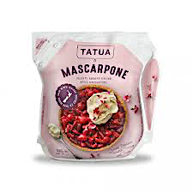
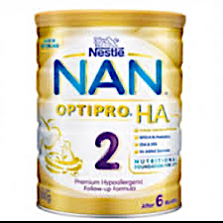
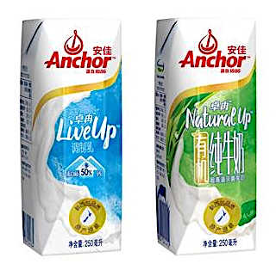
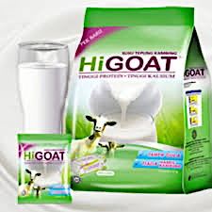
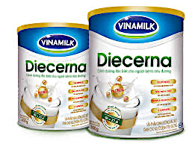
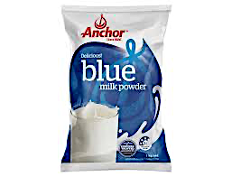
UHT Milk exports are growing and the product plays to New Zealand strengths in shelf-stable dairy - AGVC-D
EXAMPLE: DAIRY PRODUCTS ON SHELF IN ASIA
US$; m; 2003-2015
Hong Kong SAR
Singapore
China
Philippines
Vietnam
Malaysia

Slide 37
Horizon 3, AGVC-D is creating and nurturing a wide range of viable options for future export success
THREE HORIZONS OF GROWTH FRAMEWORK: AGVC-D
Model; 2017
HORIZON 3
Create viable export options
HORIZON 2
HORIZON 1
Build emerging export products
Mature export Categories & products
Strategic focus
Defend and extend profitability
of core business
Expand and grow emerging
businesses and products
Develop and discover new options for growth
Key success factors
Efficiency and cost control
Process innovation,
Scale,
Supply chain
Customer acquisition
Speed and flexibility
Execution
Resource/ funding
Risk taking
Market insight
Business mode innovation
Culture and incentives
Key metrics
Profits, margins and costs
Strategic focus
Whole milk powder
Butter
Lactose
Yoghurt
UJT Milk/ Fluid Milk
Also a range of processes foods With significant dairy ingredients (eg. Sport nutrition, infant formulas, etc. see processed foods document
Alternative dairy (eg. Plant-based)
Sheep milk products
Dairy-based nutraceuticals
New unique cheeses
New unique milk based beverages
Source: Mckinsey & Co. ; AGVC-D

Slide 38

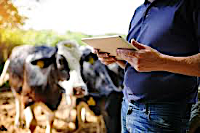

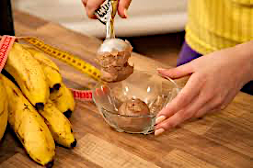
Four broad global consumer mega-trends are driving growth and new product development in the F&B industry
FOUR CONSUMER FOOD & BEVERAGE MEGA-TRENDS
I am concerned about my health and am trying to live a healthy lifestyle
I am mindful of where my food comes from and how it is produced
I am trying to achieve work-life balance and need quick and easy meal solutions
I like to indulge in rich and sumptuous living beyond bare necessities
Mid income nations experiencing an aging population
Spread of western lifestyle and Western diseases of affluence (e.g. diabetes)
Ongoing waves of media hype around fad diets and new ‘superfoods’
Food presented and viewed as both the problem and the solution
Domestic global shift to city living; 1800=3%, 1900=14%, 2015=50%; developed nations 75%+; 400 cities 1m+
Loss of attachment to the land and food production
Ongoing ‘rights revolution’ now spreading to animals
Ongoing waves of food scares around contamination, additives
Dramatic increase in female participation on the workforce globally
Consumers working longer hours to maintain relative income
Work hours no longer just ‘9 to 5’; food needs at all times (e.g. night shift)
Growing income polarization into ‘haves and have nots’
Strongly emerging trends to premium (and discount) at the expense of the mid-market
Emerging middle class across developing world driving consumption growth
Incredible power of food and beverages in many social settings
May be addressing specific conditions (e.g. weight management cholesterol)
May target a specific family member (e.g. grandparent
May reflect wider ‘healthy living worldwide’
May target specific foods perceived as high risk, unethical or visible (e.g. coffee, tea)
May target as specific family member (e.g. child)
May represent a need for an immediate solution (e.g. thirst)
May represent an easy solution to a future challenge (e.g. children’s lunches)1
May range from ‘everyday luxury’ to an occasional ‘treat’
May be used to demonstrate social status, taste or style
Source: Boston Consulting Group; Datamonitor. ; AGVC-D

Slide 39

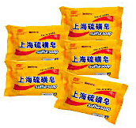

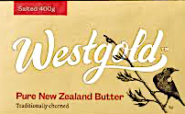
Four broad global consumer mega-trends are driving growth and new product development in the F&B industry
Hong Kong SAR
Singapore
Hong Kong
Hong Kong
H&W
Whole Milk
H&W
Rich in calcium
H&W
Contains calcium
H&W
Unsalted
H&W
High in Vitamins
A&R
Cows & mountains imagery
H&W
Contains collagen
A&R
Trusted brand founded in 1937
A&R
Trusted Brand
A&R
Outline of New Zealand
H&W
Make you stronger bones, joints flexible, muscles more flexible
A&R
Imported from NZ
A&R
New Zealand Flag
A&R
Trusted Brand
H&W
Added Vit C, D & E
E&C
250g pack
E&C
Bulk pack/easy carry handle
E&C
Value pack
H&W
Value Pack
S&I
Gold foil packaging
E&C
Shelf-Stable
E&C
Single serve slices
A&R
Packed in Malaysia from NZ milk powder
E&C
Ready-to-drink 250ml size
E&C
Ready-to-eat
E&C
Shelf-stable
S&I
Cartoon cow
S&I
Excellent creamy taste
E&C
Just add water
Source: photo credit (various firms or fair use; low resolution; complete product/ brand for illustrative purposes); various articles; AGVC-D

Slide 40
These trends drive new product development, through (1) packaging (2) product, (3) category and (4) channel
innovation, success, however, often comes down to implementation and execution
CONSUMER FACING INNOVATION IN THE FOOD AND BEVERAGE INDUSTRY FROM TREND TO EXECUTION
Model; 2017
CONSUMER FOOD & BEVERAGE MEGA-TRENDS
NEW PRODUCT DEVELOPMENT
PACKAGING INNOVATION
PRODUCT INNOVATION
CATEGORY INNOVATION
CHANGE INNOVATION
Usage(e.g. Ready to use)
Shelf-life (e.g. UHT)
Convenience (e.g. multi pack)
Appearance (e.g. foil pack)
Cost (e.g. plastic Vs glass)
Flavour
Formulation/ recipe
New/different/ ingredients
Source/origin
Production system
Manufacturing process
Line extension
Creation of new category
New temperature state
Foodservice offer
Non-foods retail offer
Vending
Internet/Home delivery
Own retail stores
IMPLEMENTATION & EXECUTION

Slide 41
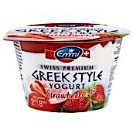
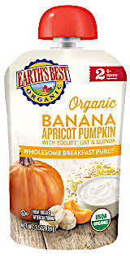
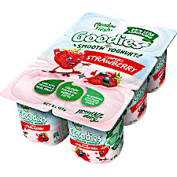
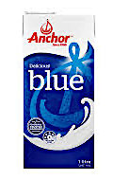
Global Dairy firms are delivering on packaging-driven technology
PACKAGING
INNOVATION
SELECT EXAMPLE OF PACKAGING INNOVATION: DAIRY FIRMS
Model; 2017
INSIGHTS
COMMENTARY
Failing freight costs and rising energy cost changing fluid milk economics
Strong demand from Chinese consumers for trusted liquid milk
Fonterra reinvesting in UHT packaging, including new and upgraded lines
Launch of over-wrapped pack of 12
Traditionally nations produce transport-friendly dairy products (e.g. cheese, butter)
Driven by location and use of sea freight (for cost competitiveness reasons)
Emergence of new packaging forms, materials and technologies (e.g. aseptic pouch) is ongoing globally
Creating opportunities for long distance exports from NZ to key markets
End of Dairy Boards has enabled new investment and greater innovation
Further innovation in longer shelf life, in particular, would enable further penetration of produced consumer-ready products into numerous consumer-ready products into numerous new categories (e.g. drinking water)
New packaging is often linked with new processing technologies (e.g. high pressure processing (HPP))
INSIGHTS
New packaging technology enables emergence of new yoghurt sub-category
Product is single serve, re-scalable, ready-to-drink and ‘school ready’
Packaging delivers longer shelf life
INSIGHTS
Traditional milk powder in a tin/bag revitalized with new packaging form
Product is single serve, ready-to-drink
New flavors (eg. Black sesame & collagen, White tea)

Slide 42
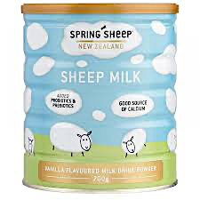
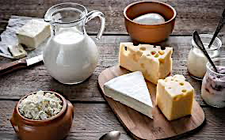
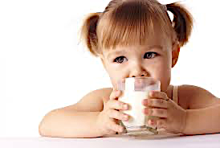
Dairy firms are delivering on product-driven innovation
PRODUCT
INNOVATION
SELECT EXAMPLE OF PRODUCT INNOVATION: NEW ZEALAND FIRMS
2017
COMMENTARY
Traditionally nations produce transport-friendly dairy products (e.g. cheese, butter)
Driven by location and use of sea freight (for cost competitiveness reasons)
Emergence of new packaging forms, materials and technologies (e.g. aseptic pouch) is ongoing globally
Creating opportunities for long distance exports from NZ to key markets
End of Dairy Boards has enabled new investment and greater innovation
Further innovation in longer shelf life, in particular, would enable further penetration of produced consumer-ready products into numerous consumer-ready products into numerous new categories (e.g. drinking water)
New packaging is often linked with new processing technologies (e.g. high pressure processing (HPP))
INSIGHTS
INSIGHTS
INSIGHTS
Lewis Road Cremery founded in 2011 by Peter Cullinane, ex Saatchi & Saatchi
Started selling range of gourmet organic and non organic milk in 2013
Extended into flavoured milks, butters(truffle & chocolate), custard, ice cream and most recently chocolate cream liqueur
Cobrand with premium, iconic brands ‘Whitetaker Chocolate’, ‘Heilala Vanilla’
Organic range in line with health and wellness and authentic and responsible
Premium chocolate, custards, truffles in line with sensory and indulgent
Fonterra’s “Anchor Candy Cheese”
Launched in Hong Kong, Nov 2016
Convenient bite-sized cheese cubes
Nutritious children’s lunch and snack
In line with health and wellness mega drivers
Diversifying offer and range to consumers
In line with rising consumption of dairy in Asia
In line with consumer demand for high protein diets
Spring Sheep jointly owned by Landcorp Farming Ltd (Govt owned) LIC and Spring Sheep
Producers of: Frree range sheep whole milk powder, gold probiotic sheep milk drink and calcium chews
Food Awards 2016: Artisan Food+ Business Innovation Award Finalist+ Primary Sector Winner
In line with health and wellness and authentic and responsible mega drivers; high nutritional value, high protein, easier to digest than cow milk
Supported by PGP new sheep funding programme in 2016 ($31m over 6 years)
Source: photo credit (various firms or fair use; low resolution; complete product/ brand for illustrative purposes); Fonterra; various articles; AGVC-D

Slide 43

Model Case – beverage firms are supported with access to advice, research facilities and pilot plants across
Five locations
NZFIN
FOOD INNOVATION NETWORK
LOCATION
FOCUS
CAPABILITIES
FOODBOWL
Extrusion & Milling/Blending
Liquids/Beverage
High pressure processing
Freeze drying
General processing
Multiple packaging styles
Product development kitchen
Processed/FMCG foods Space/ equipment for hire Export registrations-1000 kg/shift
FOODWAIKATO
Spray dryer
Evaporator
Other diary equipment
Packing
Powder(vegetable)
Dairy & infant formula
-500 kg/hour vegetable
HAWKES BAY
Specialist expertise
Business development
Direct to other facilities
All foods and beverage
FOODPILOT
Same equipment as Manukau(1/5th scale
Same equipment as Waikato(1/20th scale)
Meat and small goods pilot plant
Located at Massey University
Dairy Fruit & vegetable/ All foods and vegetable
FOODSOUTH
Mixing/Blending/Emulsifying
Extrusion
Freezing/Cooking/Baking
General Processing
Product Development Kitchen
Technical and Business development expertise
Processed/FMCG Foods Space/ equipment for hire Export registrations 20-200L batch size

Slide 44
Ability to reach Target Market
AGVC-D
CAPTIVE DAIRY FIRMS
History and context
Enterprises
Production share
Employment
Financial performance
Ownership
Foreign Investors
Acquisitions
Investments
Firm profiles
04

Slide 45
AGVC-D has a strong and growing dairy industry that continues to attract investment
KEY METRICES
FINANCIAL PERFORMANCE
INVESTMENTS
The number of dairy processing firms has grown, particularly since the signing of the NZ/China FTA and the melamine crisis in China
Considering large raw milk/primary processing dairy plants, averaging 498m l/plant
Recent entrants are rapidly (17% CAGR) growing their share of the raw milk supply
Employment in dairy processing is growing
Dairy processing is spread across the nation
Fonterra accounts for ~80% of NZ dairy employment
Fonterra continues to be the largest dairy firm in NZ by turnover, though there is now a strong second tier
Firms profitability (EBITDA) performance varies by firm, but is generally in line with global needs
Financial performance of key firms varies, with A2 and Synlait standing out for profitability and A2 also standing out for return on assets
Ten years growth of the current top ten highlights the rapid growth of new entrants
NZ dairy industry has a range of owners, ~85% of the industry is still owned by farmers
NZ dairy industry has attracted international investment from a range of sources
New firms continue to invest in the NZ dairy industry
Firms continue to make major investment in plant or equipment
Swiss dairy firms are also investing in new and improved marketing
New leadership continues to enter the industry or be promoted from within

Slide 46
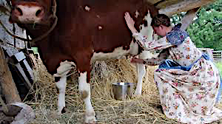

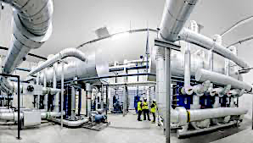
A long history in dairy which has moulded the current industry structure - AGVC-D
PIONEER ERA (1814-1923)
DAIRY BOARD ERA (1923-2001)
INNOVATION ERA (2000+)
Creating
Improving
Innovating
Dairy cows introduced in 1814 and are suited to climate, industry grows rapidly
Numerous regional farmer owned dairy co-operatives formed to produce export products
Over 600 dairy processing factories by 1920
Industry is lightly regulated and quality is variable
Widespread product innovation( e.g. Glaxo (GSK) founded in NZ to produce infant milk)
Early experiments with milk powders
Government allows mega merger of the two largest processors (95% of volume) and the NZ Dairy Board into Fonterra
Multiple waves of new dairy firms launched across the nation
Range of global investors begin investing in NZ dairy production and processing
Range of innovative new products launched
Industry regulated by government in 1923 to create an orderly market and standardize product quality across processors
Dairy Board primarily a marketer but with some in-market processing; hundreds of individual dairy processors were suppliers to it
However, industry consolidation was ongoing via 20th century until only four large firms remained (driven by fewer, larger factories)
Board also funded many industry-good activities (e.g. breeding, science funding)
Numerous improvements to industry systems and technology, particularly in milk powder

Slide 47
The number of dairy processing firms in New Zealand has grown /China FTA and the melamine crisis in China
- AGVC-D
NUMBER OF DAIRY PROCESSING ENTERPRISES
Enterprises, 2000-2015
126
126
NZ/China FTA
Melamine Crises
111
Deregulation
Formation of Fonterra
87
84
78
72
60
57
57
57
57
57
57
51
2011
2006
2012
2000
2007
2013
2015
2008
2009
2001
2004
2010
2014
2002
2005
Source: 2015 data latest available for Feb 2017; 1. Defined s C113-100 Milk & Cream processing and C113-300 Other Dairy processing;
Source: Statistics NZ business demographics database; - AGVC-D

Slide 48
Range of Participants - AGVC-D
DEFINED DAIRY
DEFINED PROCESSED FOODS
LARGE PRIMARY DAIRY
LARGER SECONDARY DAIRY
LARGER SECONDARY DAIRY
MEDIUM/SMALLER
SECONDARY DAIRY
MEDIUM/SMALLER
SECONDARY DAIRY
MEDIUM/SMALL FLUID MILK
MEDIUM/SMALLER SECONDARY DAIRY

Slide 49
Dairy processing is spread across the country - AGVC-D
10Y CHANGE IN DAIRY PROCESSING EMPLOYMENT BY REGION
ABS; CAGR 2015 total headcount, as of Feb 2000 vs. 2015
10 Y CAGR
9%
8%
SOUTHLAND
7%
6%
CANTERBURY
5%
TARANAKI
WAIKATO
4%
AUCKLAND
3%
2%
MANAWATU-WANGANUI
1%
0
OTAGO
-1%
1000
OTHER
Bubble size is proportional to employment
In 2015; a bubble this size is 1000 people
2%
3%
0
500
1000
1500
2000
-1000
-500
Note: data is geographic units( does not match enterprise units page prior) Taranaki, Other NI & Other SI are AGVC-D are AGVC-D estimates of confidential
data from total and past data; 2015 data latest available as Feb 2017; 1 Defined as C113-1– Milk & Cream processing and C113-300 Other dairy processing;
Source: Statistics NZ business demographics database AGVC-D

Slide 50







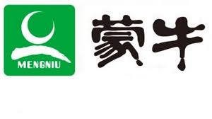
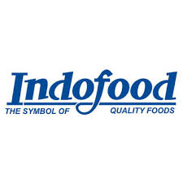











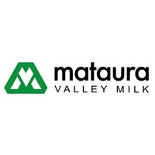
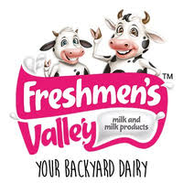

Sources of international investment from a wide range into Dairy industry - AGVC-D

Slide 51
Three key drivers support the ongoing investments in the Dairy industry- AGVC-D
1. EXTENDING VALUE ADDED CATEGORIES
2. INCREASING SCALE AND EFFICIENCY
$240m
$157m
$11m
-
Investment in new mozzarella plant(#3)
At site; IQF
Milk protein concentrate plant, reverse
Osmosis and AMF plant
Actoferrin plant expanded to double
production
$235
$38m
$30m
-
Plant upgrade and new dryer
-
Plant external overhaul and new
water treatment
Plant upgrade complete – cheese slices
-
-
$130m
-
Expanded Plant
$102m
-
New infant formula drier
-
$200m
-
Expanded processing capability,
Milk powder and cheese processing
at factory
$300m
-
Plant to invest additional funds for UHT
Milk products; infant formula canningm
lactoferrin
$10m
-
Expanded manufacturing capability-
New goat spray dryer at existing plant
$300m
-
Expanded plant, consumer packaging,
cream
3. SECURING SUPPLY
$10m
-
Mataura Valley Milk constructing new
Nutritional milk plant
$40m
-
New Plant for UHT processing
$25m
-
Invested in new blending and packaging
“Mega-facility” including new canning line
Plan to build and run blending and canning
Plant (form JV ‘pure nutrition’ with Ausnutria
(China)
$32m
-
$15m
-
Built new spray dryer at plant at recently
Acquired site

Slide 52
Building capability across the supply chain in niche dairy, with significant investment in both goat and sheep
Industries - AGVC-D
Largest goat infant Formula
manufacturer in China
Private Investor
(Milk, CN)
Blue River Nutrition(HK)
Yuanrong Chen
New Image Group(NZ)
NZ based nutritional products firm
INVEST IN
INVEST IN
INVEST IN
INVEST IN
Investment in $40m goat
infant formula blending & packing
(aiming for dryer)
Investment in sheep genetics, new sheep
farm and sheep powder production
Acquired Blue River
Infant formula facility
Adds goat spray dryer
Manufacturing capability
$10m; invests in farms
Note: New Zealand Dairy Products/ Carilac Dairy currently looking for $10m investment for a new vertically integrated goat and sheep milk facility; AGVC-D

Slide 53
Exit Strategy – AGVC-D
AMNAYA
Bitcoin Enabled Dairy Exchange
LONDON
At the end of Eight Years of AGVC-Dairy, a Bitcoin enabled Dairy Exchange is established

Slide 54
Thanks!
business@amnayacorp.com / +1 646 599 0344 / https://amnaya.us

